Slide 1
College Admission Agent using Retrieval-Augmented Generation (RAG) with IBM Watsonx.ai
CAPSTONE PROJECT
Presented By:
1. Abhinav Jindal-Lovely Professional University, Punjab-Btech (Computer Science And Engineering)

Slide 2
OUTLINE
Problem Statement (Should not include solution)
Proposed System/Solution
System Development Approach (Technology Used)
Algorithm & Deployment
Result (Output Image)
Conclusion
Future Scope
References

Slide 3
Problem Statement
Currently, colleges receive a large number of admission-related queries from students, which are handled manually, leading to delays and inconsistent information. It is important to provide instant, accurate responses to improve student experience and reduce the burden on staff. Eventually, an AI-powered College Admission Agent using Retrieval-Augmented Generation (RAG) can automate this process by retrieving relevant information and generating precise answers using IBM Watsonx.ai and Granite models.

Slide 4
Proposed Solution
Extract and clean text from collected PDFs or webpages.
The proposed system aims to automate and streamline responses to student admission queries using a Retrieval-Augmented Generation (RAG) based AI agent. This enhances transparency, reduces manual workload, and improves the applicant experience. The solution consists of the following components:
Data Collection:
Collect admission-related documents (prospectus, eligibility rules, fee structure, FAQs).
Include trusted online sources like official college websites or government portals.
Data Preprocessing:
Extract and clean text from collected PDFs or webpages.
Chunk the documents and embed them using a sentence transformer model.
AI Model (RAG + Watsonx):
Use a Retrieval-Augmented Generation pipeline with IBM Granite or Llama-3 models.
Retrieve relevant chunks based on user questions and generate accurate answers.
Deployment:
Build and configure the agent in IBM Watsonx Agent Lab using LangGraph + ReAct architecture.
Deploy the agent in a Watsonx Deployment Space for testing and access.
Evaluation:
Test the agent with real student questions (e.g., eligibility, fees, deadlines).
Measure accuracy based on whether the answers are grounded in documents.
Improve results by tuning the instruction prompt or updating source documents.

Slide 5
System Approach
This section outlines the overall strategy and methodology for developing and implementing the AI-based College Admission Agent using Retrieval-Augmented Generation (RAG) on IBM Watsonx.
System requirements
IBM Cloud Lite account (Watsonx.ai access)
IBM Watsonx Agent Lab with LangGraph framework
IBM Cloud Object Storage (for agent/project storage)
Web browser (for interface/testing)
Internet connection
Library required to build the model
LangChain – for RAG pipeline (if done in code)
FAISS – for document indexing and similarity search
Watsonx.ai API – to access IBM Granite / Llama models

Slide 6
Algorithm & Deployment
In the Algorithm section, describe the AI approach used to build the College Admission Agent. Here's a structured breakdown of the Retrieval-Augmented Generation (RAG) method used to generate accurate, document-grounded responses.
Algorithm Selection:
This project uses a Retrieval-Augmented Generation (RAG) architecture powered by IBM Watsonx.ai and the LLaMA-3-70B-Instruct model.
RAG combines the strengths of:
A retriever that finds relevant content from college admission documents
A large language model (LLM) that generates human-like answers grounded in those documents.
Data Input:
User Input: Questions such as “What is the eligibility for B.Tech?”
Contextual Data: Retrieved chunks from stored documents (prospectus, FAQs, fee structure, etc.)
These are embedded into vectors for semantic search using built-in Watsonx tools or FAISS (if coded).
Training Process:
No full model training is required. We use IBM’s pre-trained LLaMA model via Watsonx.
Instructions are given to the agent (in Watsonx Agent Lab) to ensure polite, relevant, and grounded responses.
Prompt tuning and embedding updates may be done to improve output quality over time.
Prediction Process:
The user asks a question in natural language.
The retriever fetches the most relevant document chunks.
These are passed with the question to the LLaMA model via Watsonx.ai.
The model generates a response based only on the retrieved information.
The user receives a clear, accurate, and context-aware answer.

Slide 7
Result
Present the results of the AI agent in terms of its accuracy and effectiveness in answering admission-related queries. Include sample user questions, AI responses, and screenshots to demonstrate how well the system retrieves and generates correct, helpful information.

Slide 8
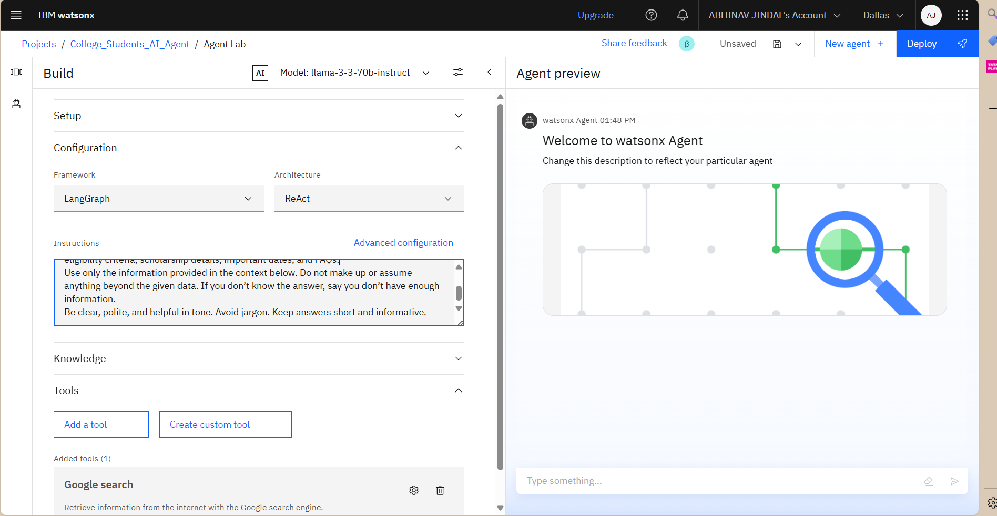
College Admission Agent – Screenshot Gallery

Slide 9
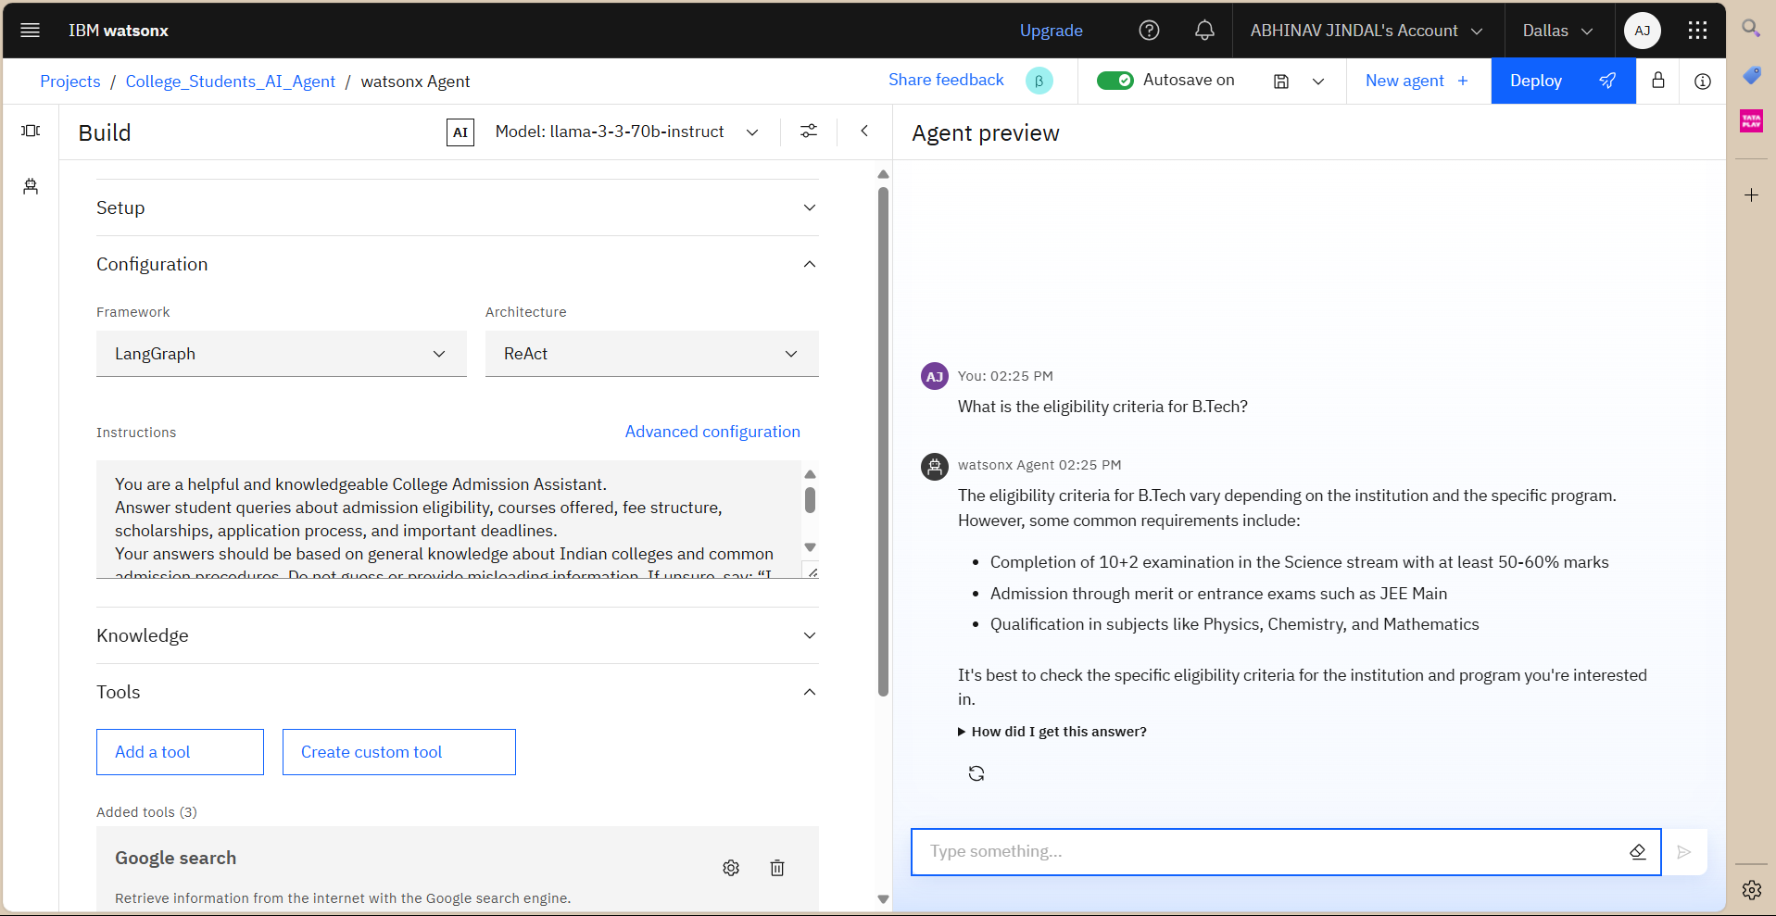

Slide 10
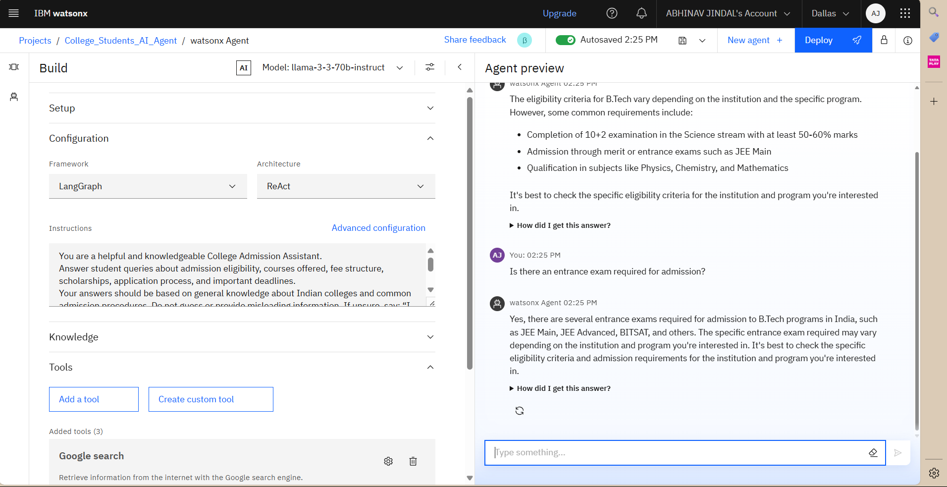

Slide 11
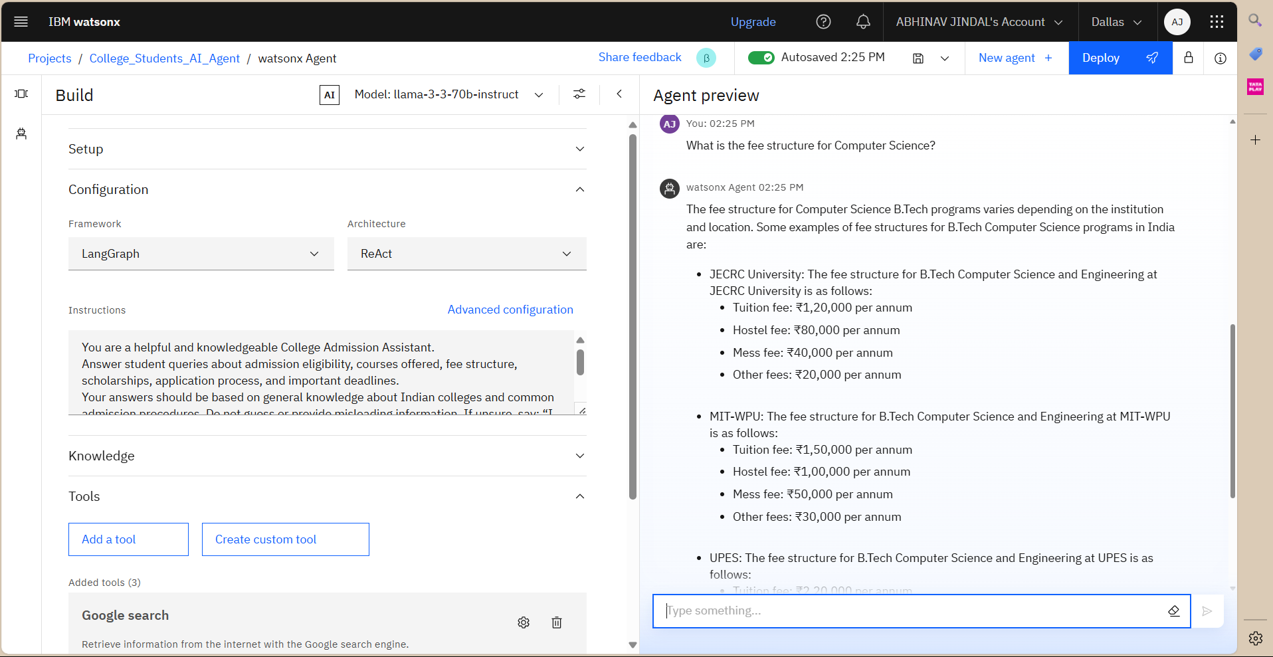

Slide 12
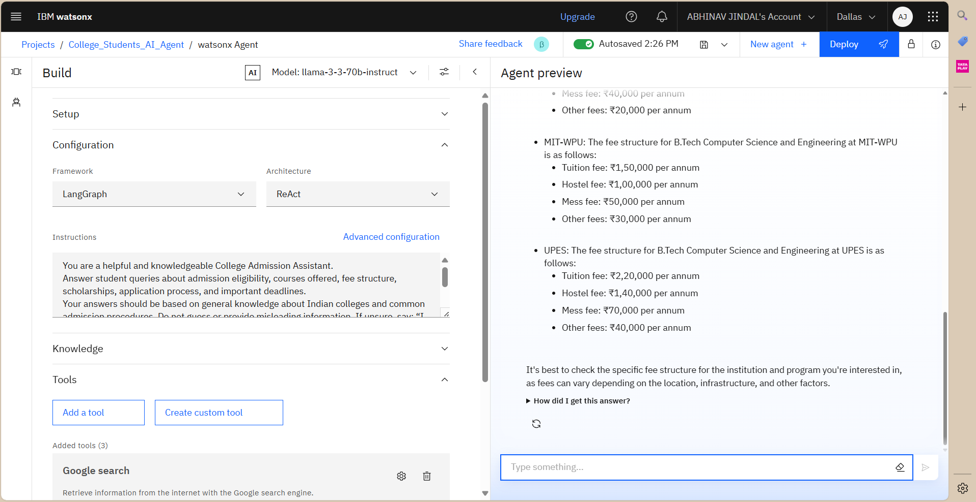

Slide 13
Conclusion
The proposed College Admission Agent, built using Retrieval-Augmented Generation (RAG) and deployed via IBM Watsonx.ai with the LLaMA model, has proven effective in addressing student admission-related queries. It accurately retrieves relevant content from institutional documents and generates clear, human-like responses in real time. During implementation, some challenges were encountered, including limitations in Watsonx free-tier features, difficulties in processing unstructured documents like PDFs, and the need to ensure that AI responses were strictly grounded in provided data. Despite these challenges, the system demonstrated strong performance and user relevance. Potential improvements include integrating real-time data sources, supporting multilingual queries, and deploying the agent through a web or mobile chatbot interface. Just as predicting bike demand is critical for maintaining a stable supply in urban areas, providing accurate and accessible admission information plays a key role in enhancing transparency, reducing manual effort, and improving the overall experience for prospective college applicants.

Slide 14
Future scope
Looking ahead, the system can be enhanced in several ways to improve its performance and usability. Incorporating additional data sources such as dynamic college databases, government education portals, or live admission updates would allow the agent to provide more current and comprehensive information. The retrieval and generation process can be further optimized by fine-tuning the embedding model or integrating advanced RAG pipelines for better accuracy and response quality. The system can also be scaled to support multiple institutions, regions, or education boards, making it more versatile and inclusive. Emerging technologies like edge computing could enable local, offline access in remote areas, while advanced machine learning techniques such as prompt tuning or multilingual transformers can enhance interaction quality. These improvements would help create a more intelligent, responsive, and accessible admission assistant for students across diverse educational ecosystems.

Slide 15
References
Lewis, P., et al. (2020). Retrieval-Augmented Generation for Knowledge-Intensive NLP Tasks. arXiv:2005.11401. ➤ Introduced the RAG architecture combining retrievers with generative models.
https://arxiv.org/abs/2005.11401
IBM Watsonx.ai Documentation ➤ Official documentation used to build and deploy AI agents and use foundation models.
https://www.ibm.com/docs/en/watsonx
LangChain Documentation ➤ For constructing the RAG pipeline, FAISS retriever, and prompt templates. https://docs.langchain.com/

Slide 16
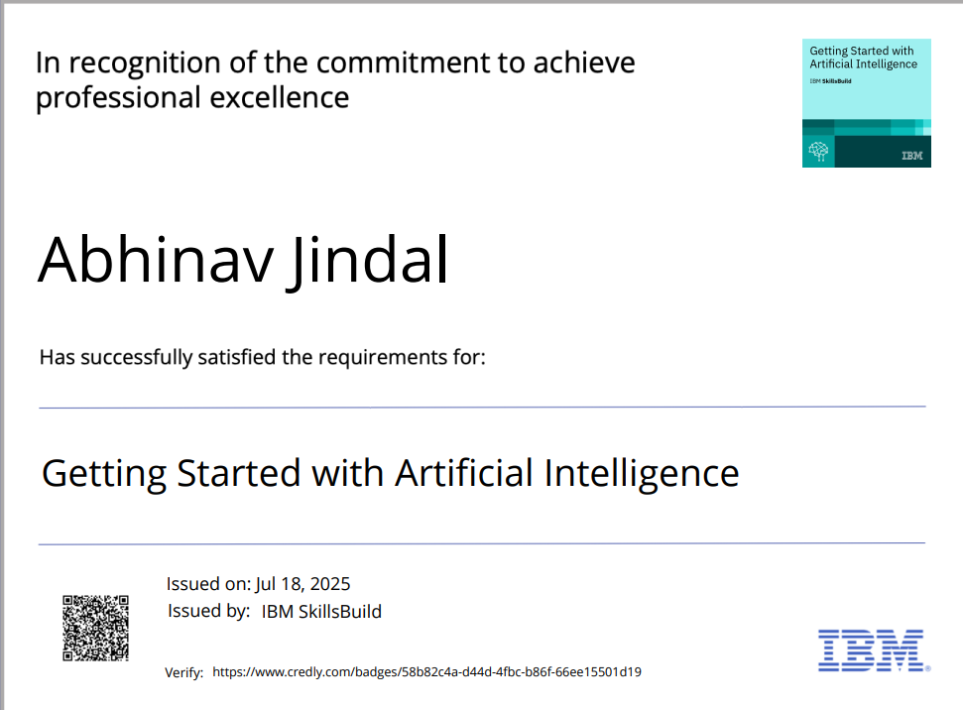
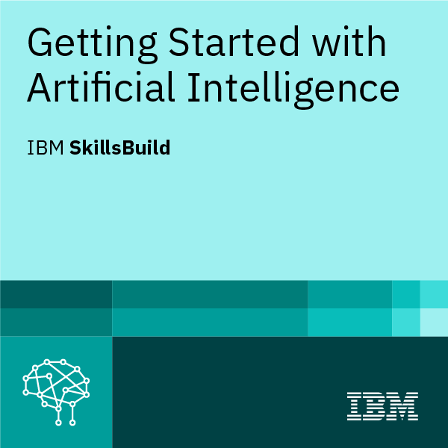
IBM Certifications
Screenshot/ credly certificate( getting started with AI)

Slide 17
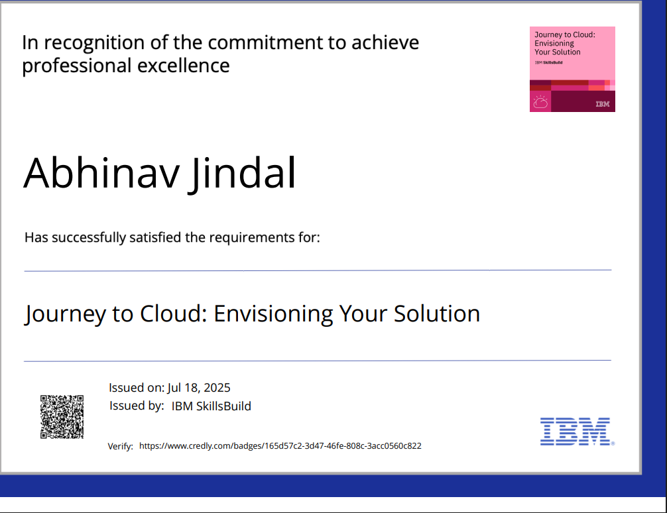
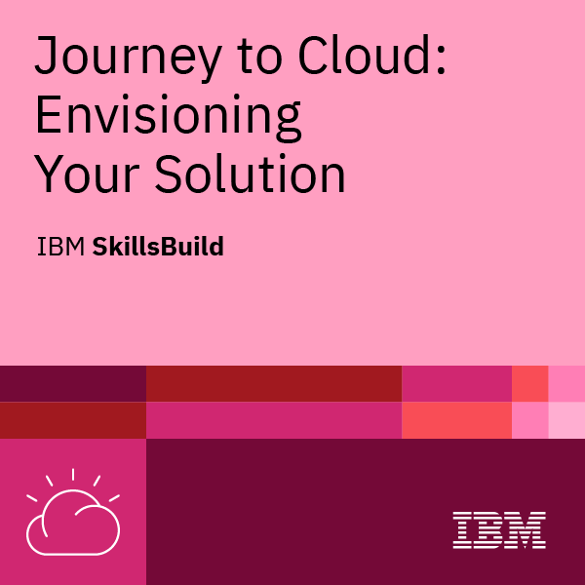
IBM Certifications
Screenshot/ credly certificate( Journey to Cloud)

Slide 18
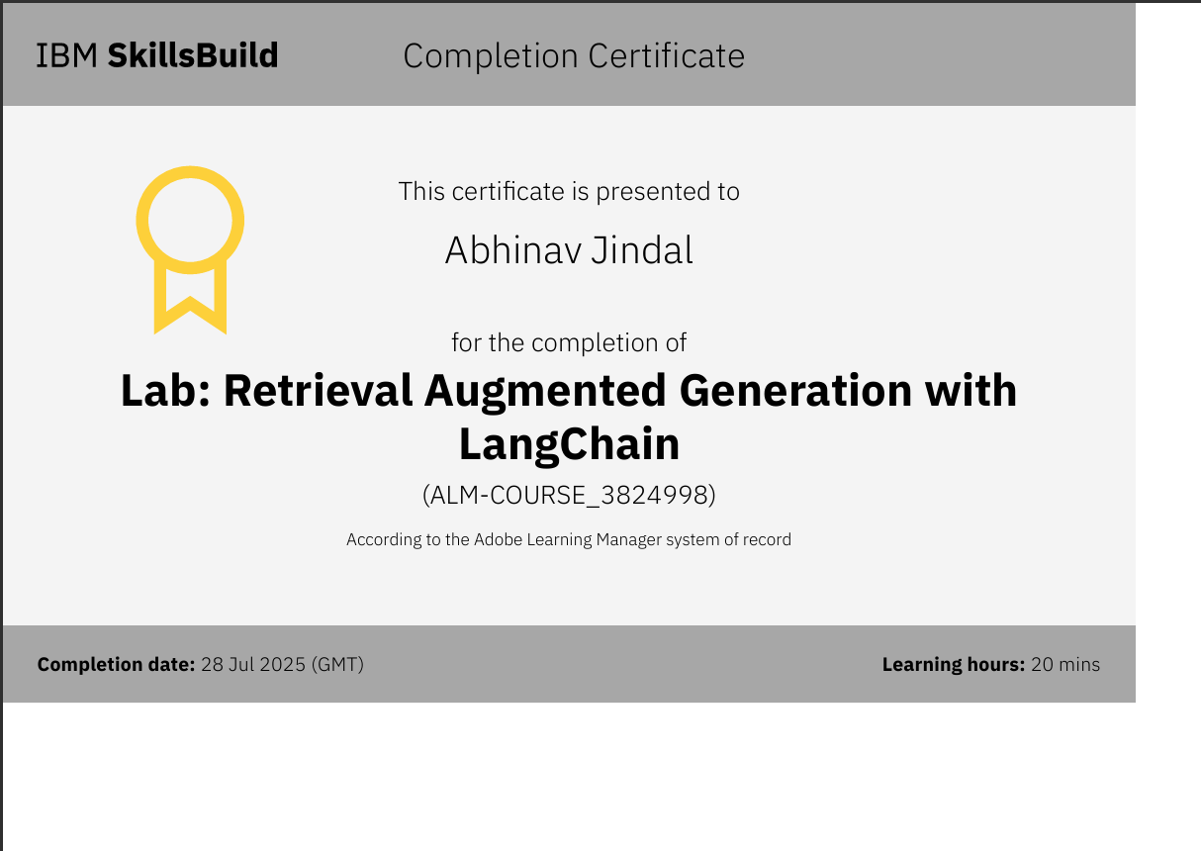
IBM Certifications
Screenshot/ credly certificate( RAG Lab)

Slide 19
THANK YOU

